Slide 1
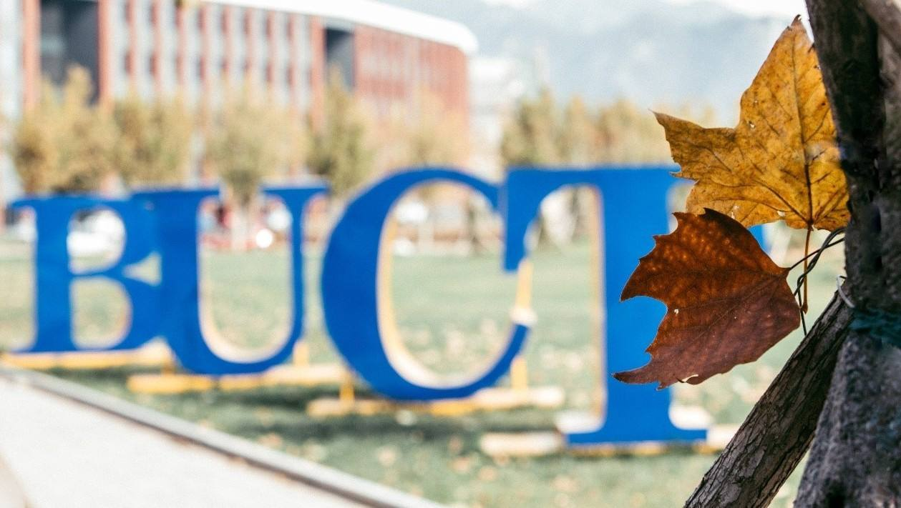

Slide 2
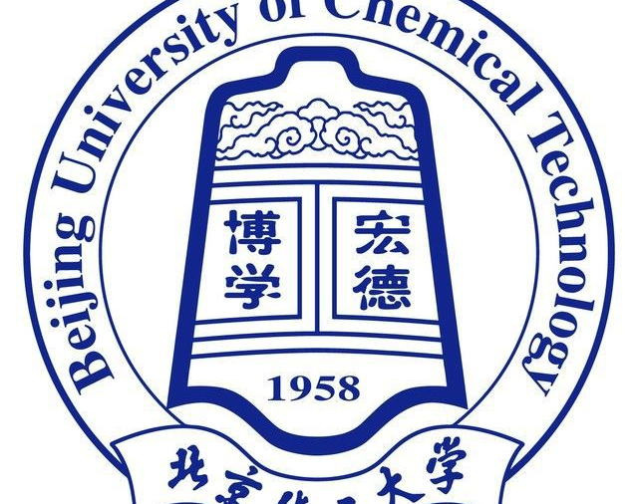
Brief introduction
The Beijing University Of Chemical Technology was built in 1958.It is one of the most famous university in China .There are 16 colleges including 55 majors .It gave birth to a lot of celebrities such as He Guoqiang ,Zhou Xiaochuan and Li Xueyong. It is a very suitable place to study and live. Everyone can realize there dream there through there efforts.

Slide 3
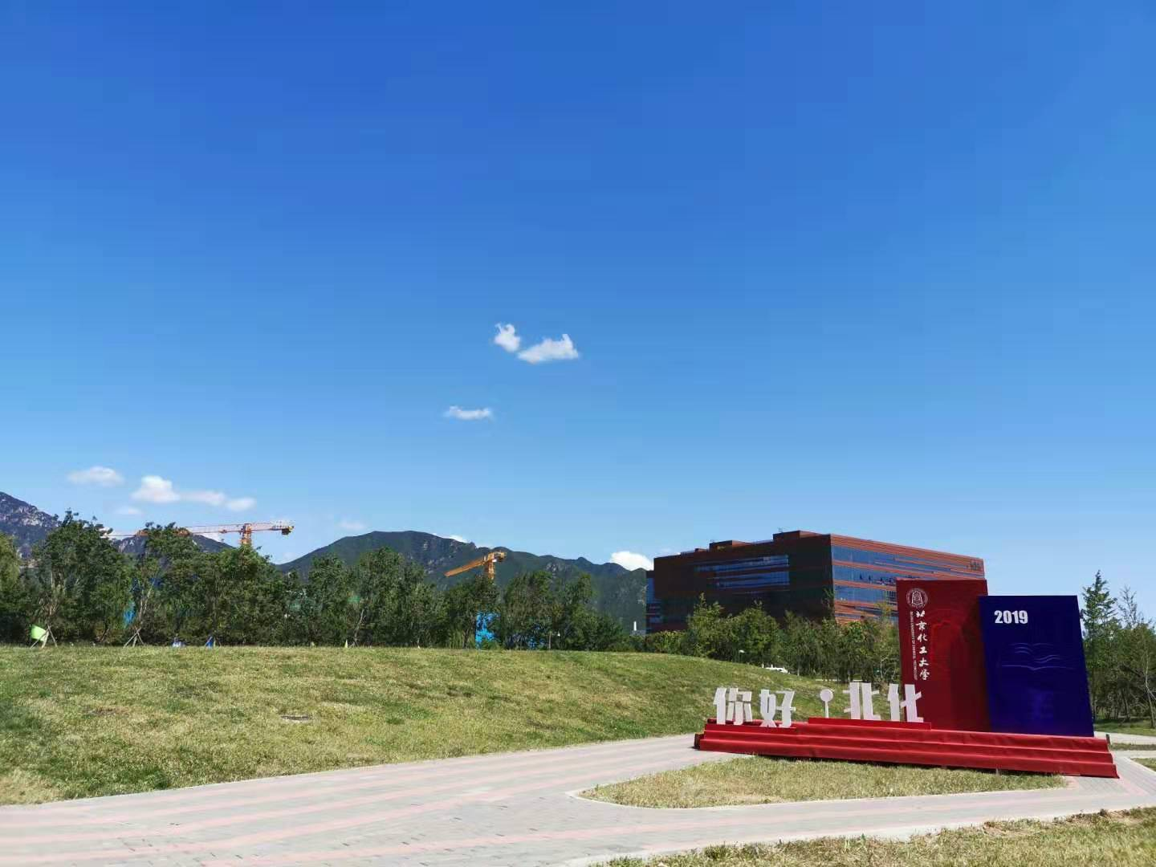
The History of BUCT
-By Cristina

Slide 4
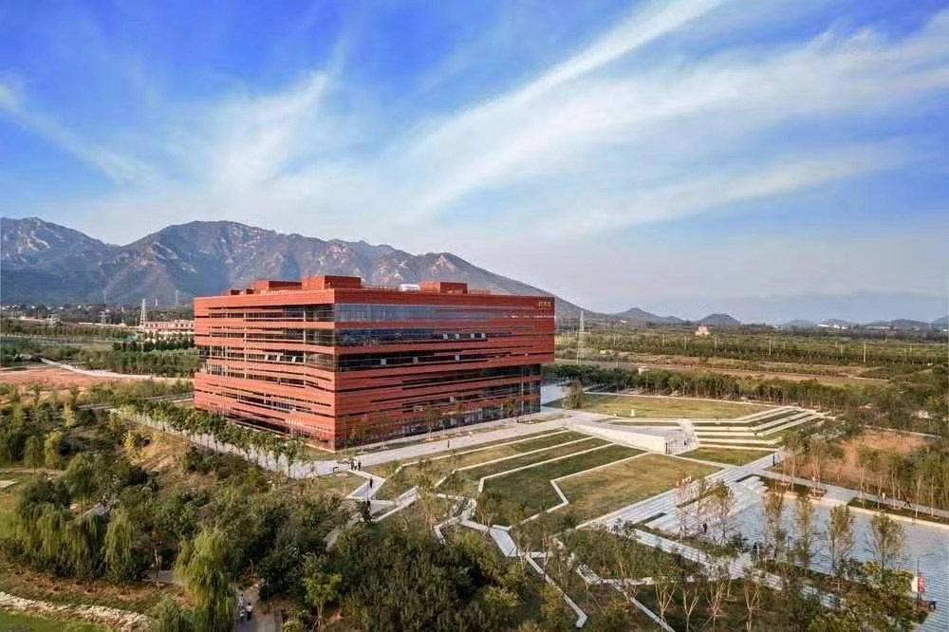
Revolution
BUCT was first founded after our premier Deng examined and approved the chemistry major of Beijing University and Tianjin University in person and signed a report in 1958,whose leadership was belonging to the original chemistry department.The offical start of school was on Sept.15,and then Sept.15 has become the School Day.

Slide 5
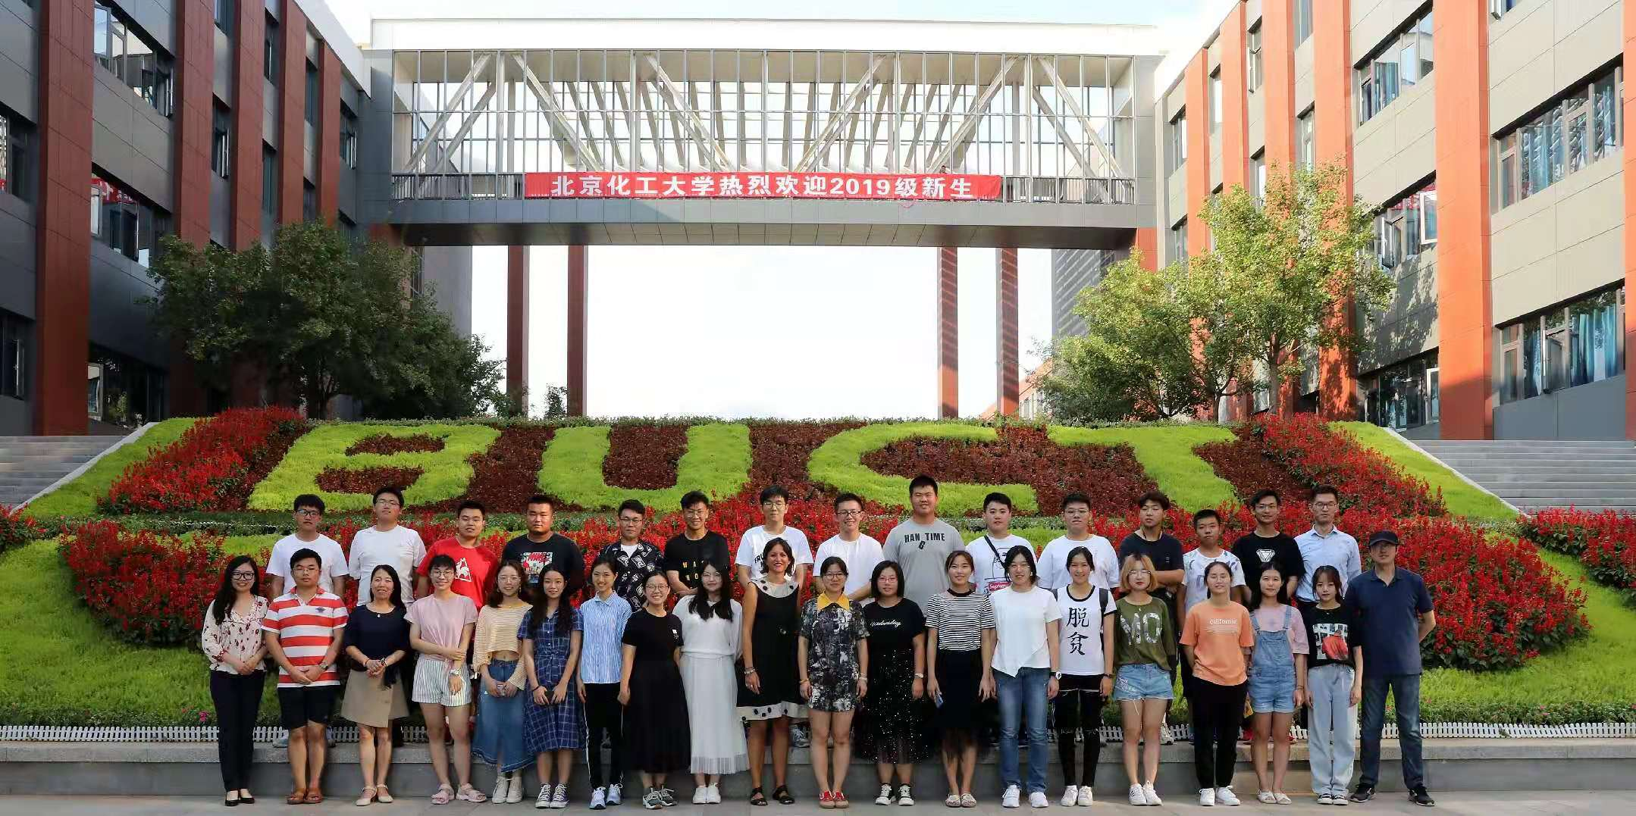
In 1960,CPC central committee decided to mark our school as one of the key universities in China.At first it had 3 departments and 12 undergraduate majors.

Slide 6
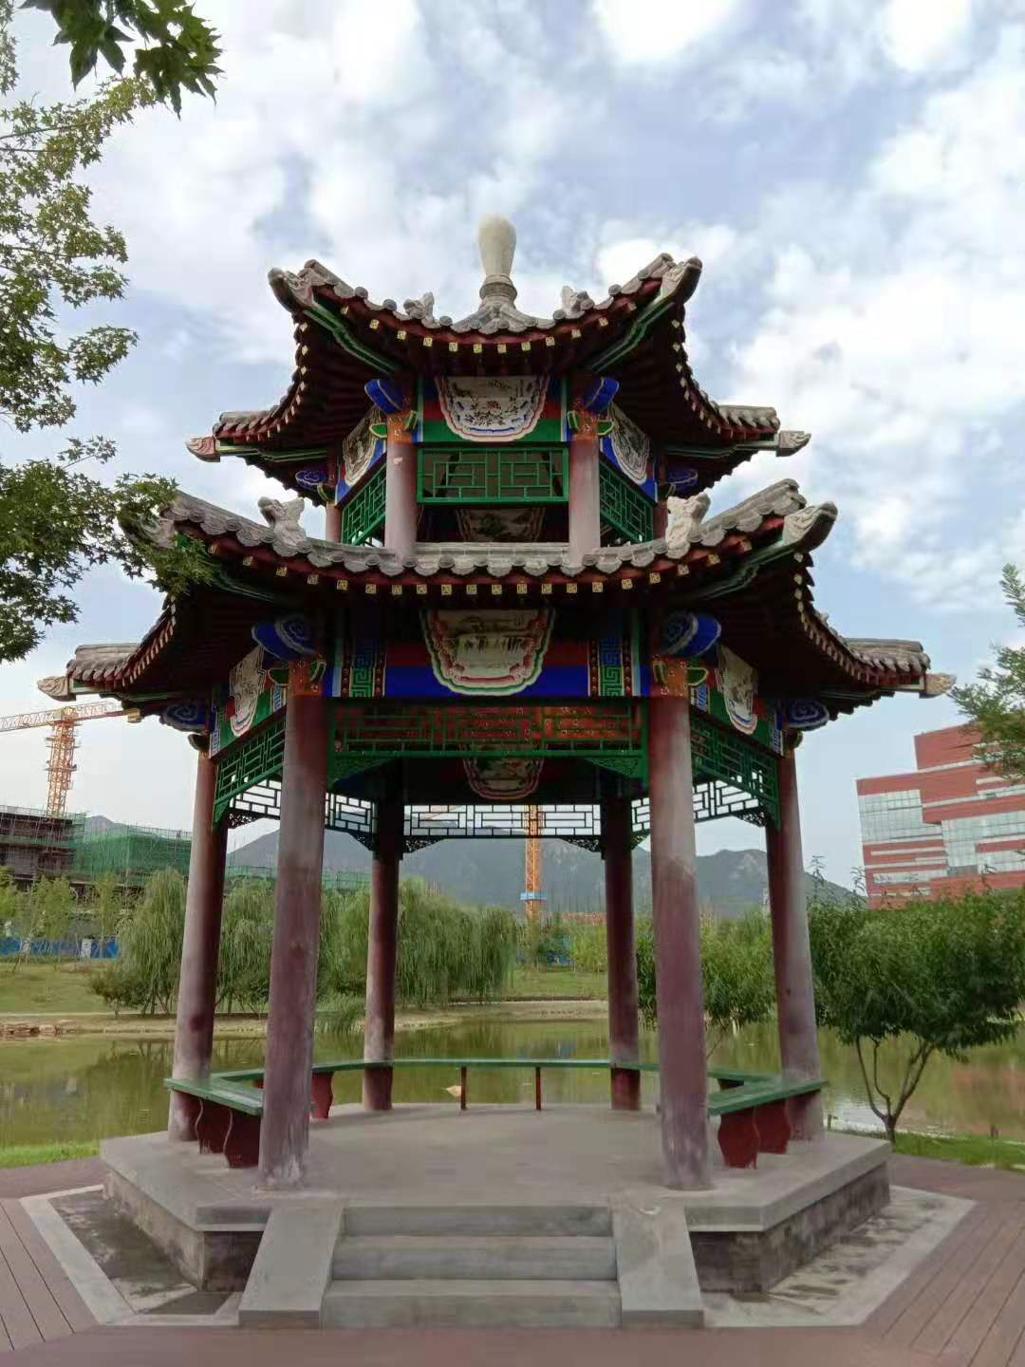
Because of the cultural revolution in1966-1970,our school experienced great damages, then BUCT paused the classes and stopped admitting students.
In 1997,our school entered the“211 program” of country’s rank . And the next year , our school was classified as a direct lying institution of the Ministry of Education . Our school passed the“211 program” and the acceptance of construction projects during the Ninth Five-Year Plan.

Slide 7
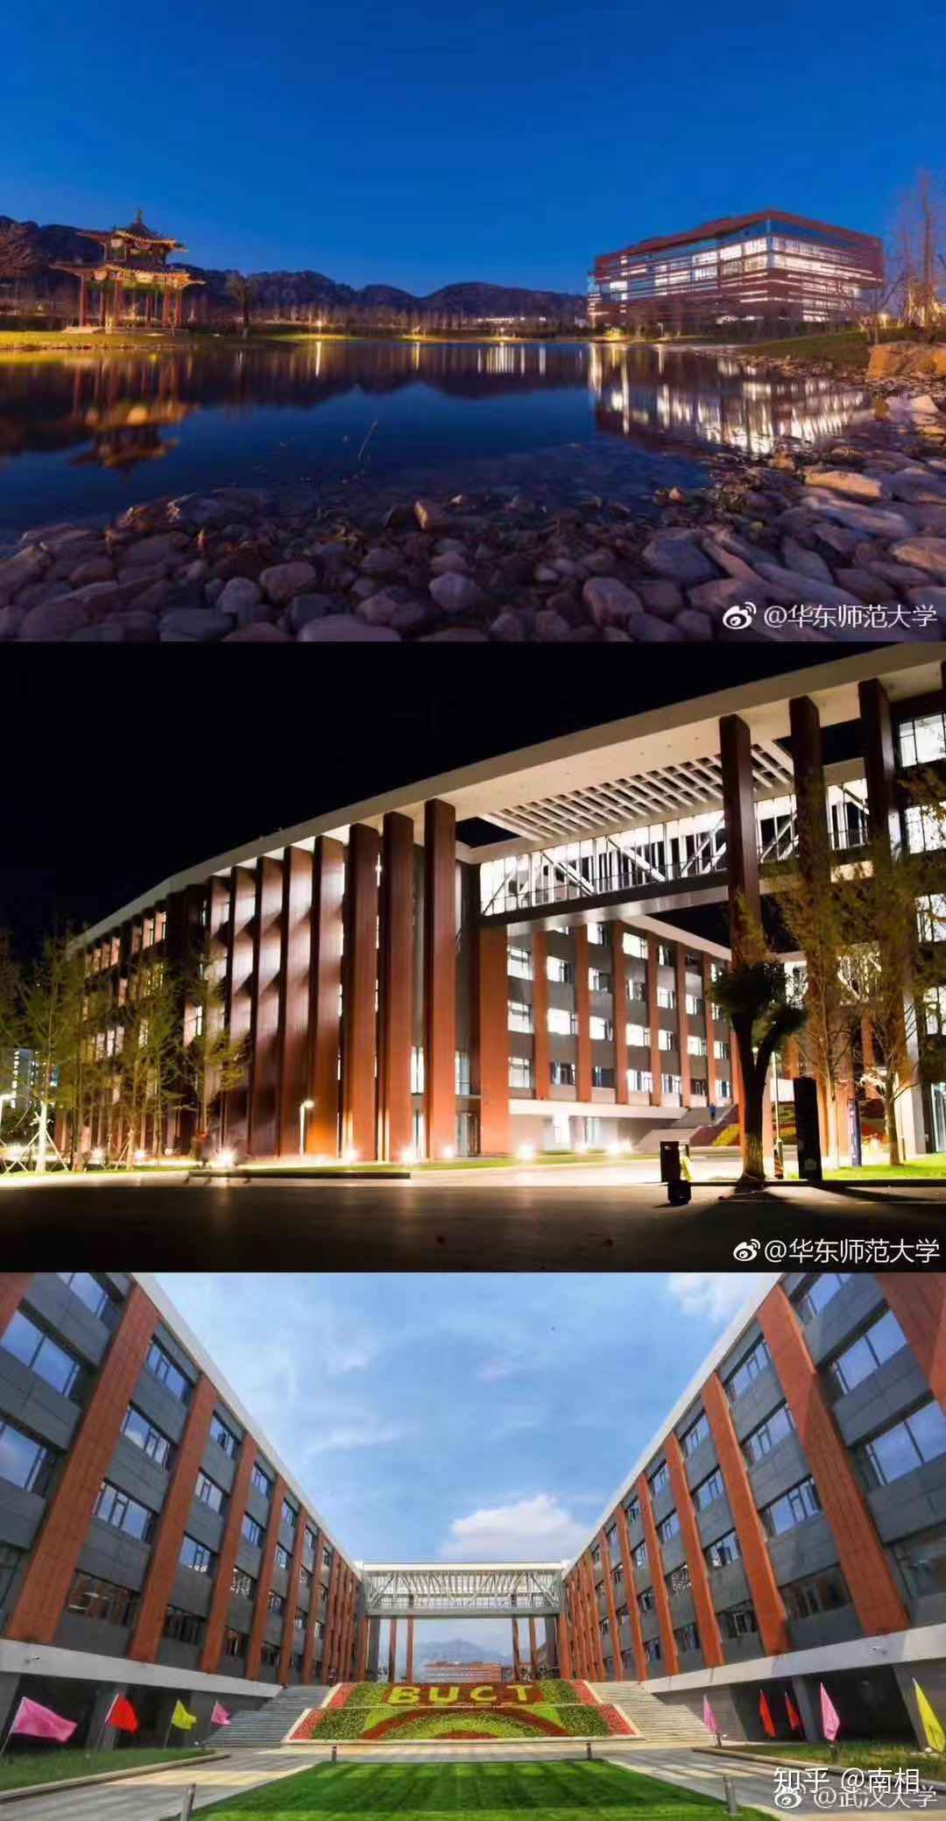
THE ENVIRONMENT
The BUCT has 3 campuses,they can be accessed by public transportation.
And the ChangPing campuse is the biggest and newest one. Thus, I want to introduce it

Slide 8
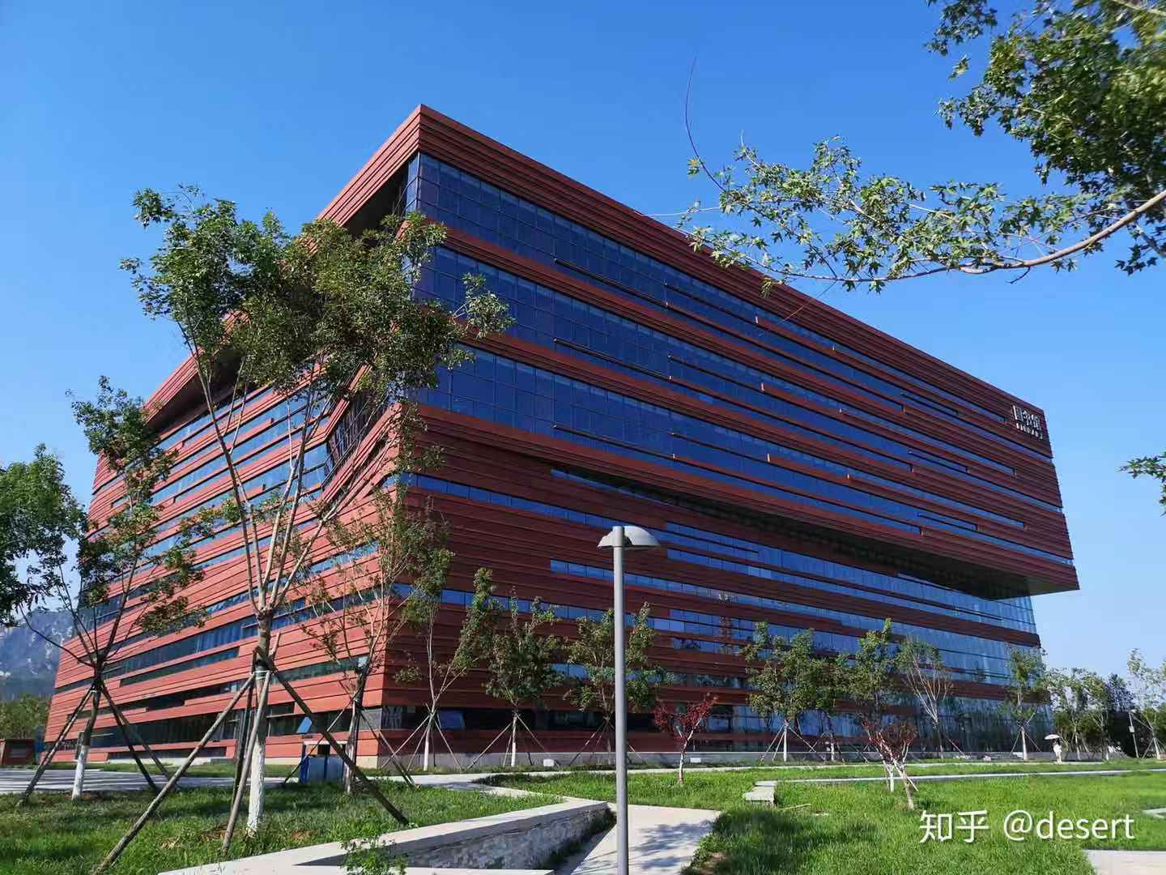
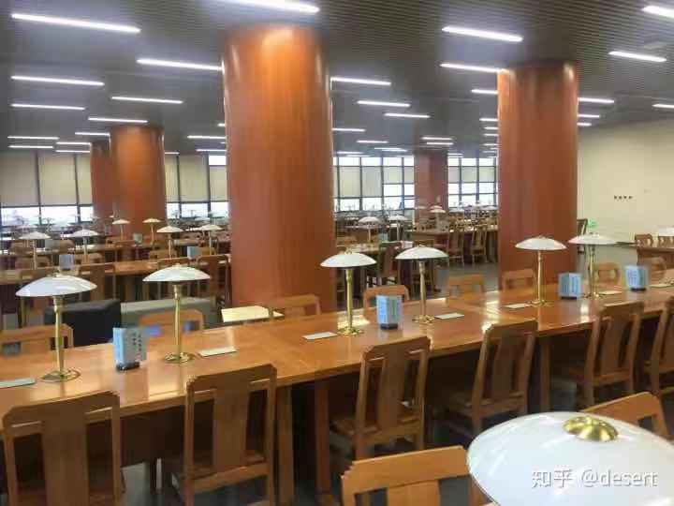
THE LIBRARY
There is a huge library ,in which you can not only read,study but also sing songs even see a movie.

Slide 9
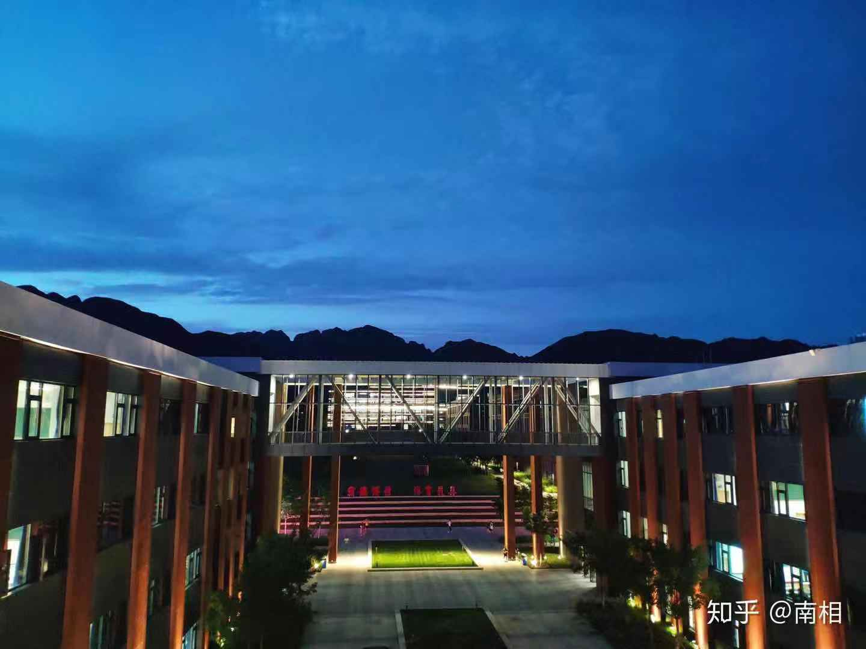
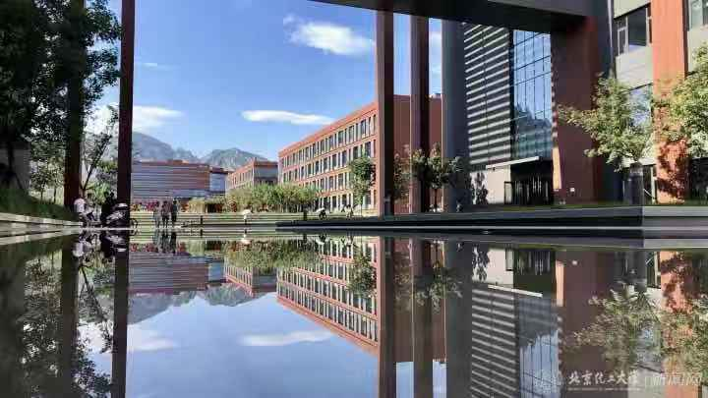
This is teaching building, bigger than what you could imagine . You can also study in the empty classroom

Slide 10
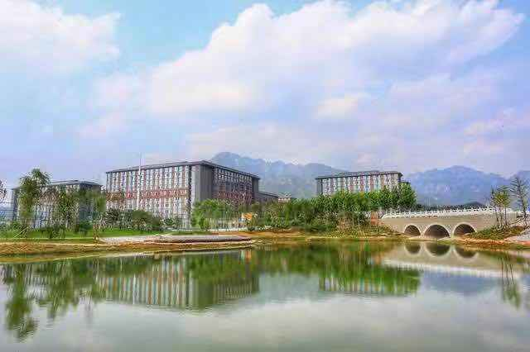
Domitory locates next to the lake and playground .If You feel tired after study,walking along the lake or running may make you relaxed.There are lots of beautiful lotus in the lake.
.

Slide 11
And that is not all….

Slide 12
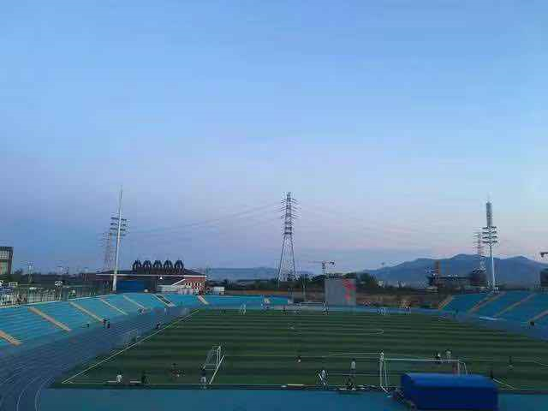
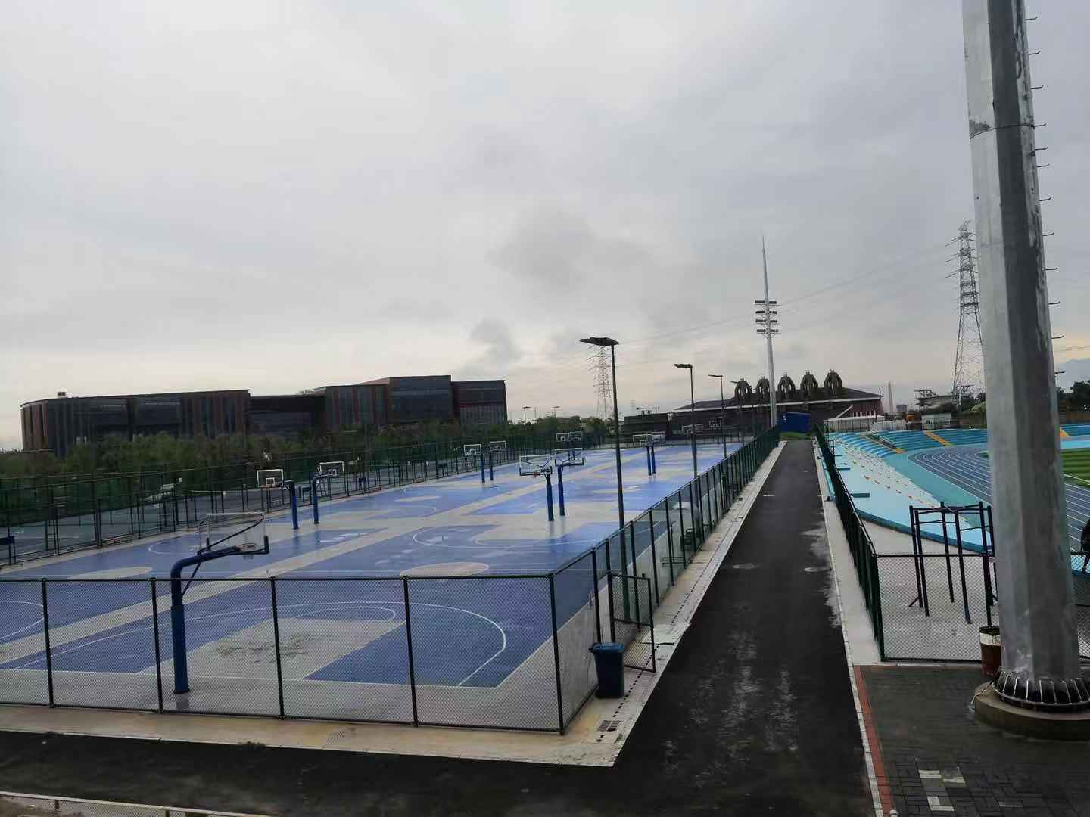
We can also enjoy the fun of sports.
Playing basketball,foot ball,volleyball outdoor as well as swim,do yoga in the gym.

Slide 13
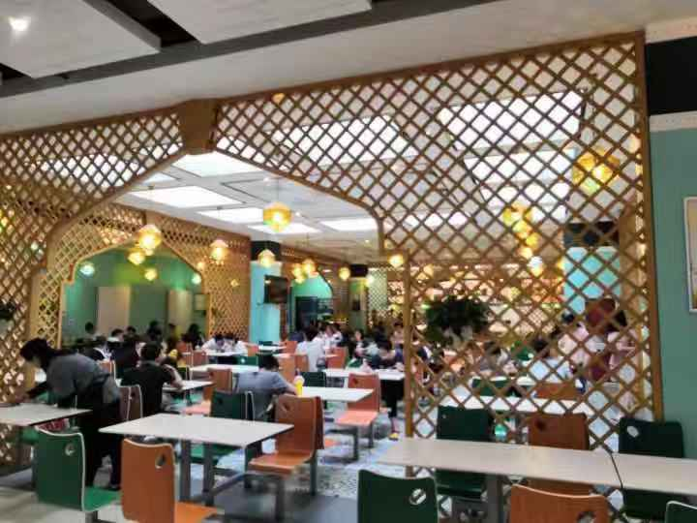
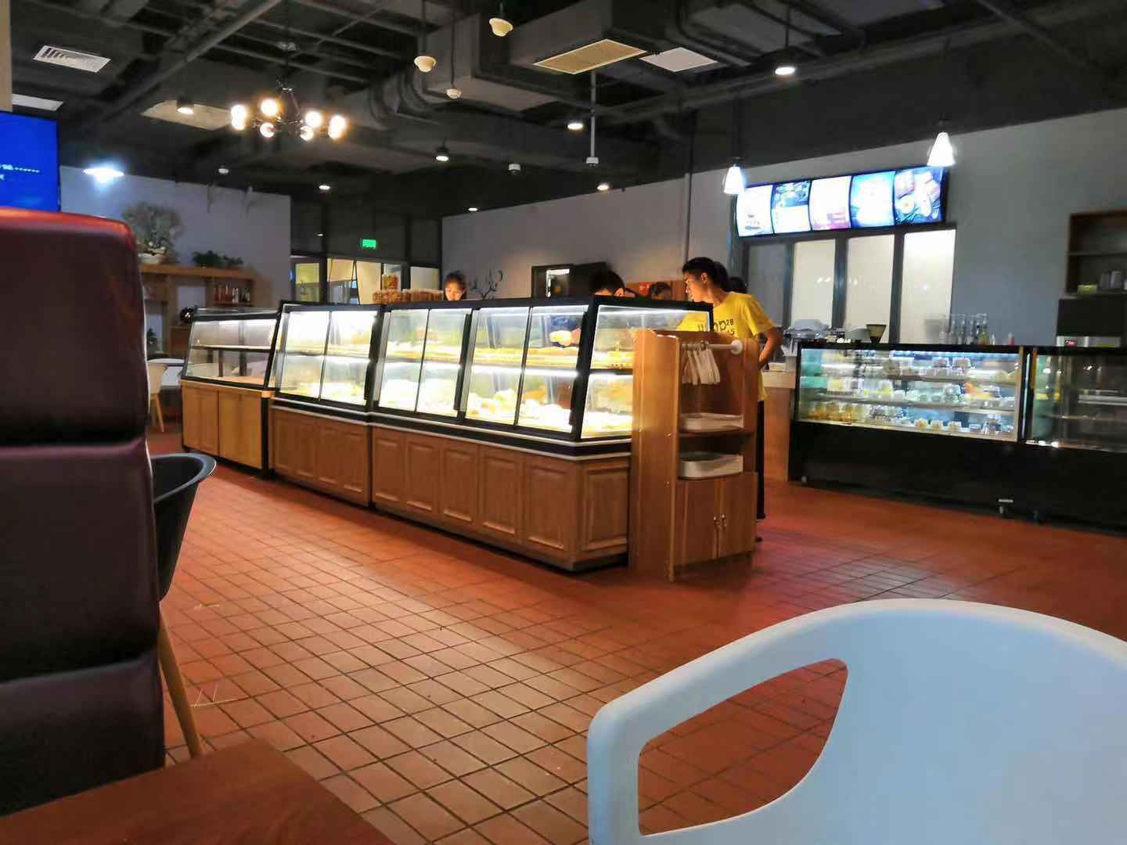
And taste many kinds of delicious food.

Slide 14
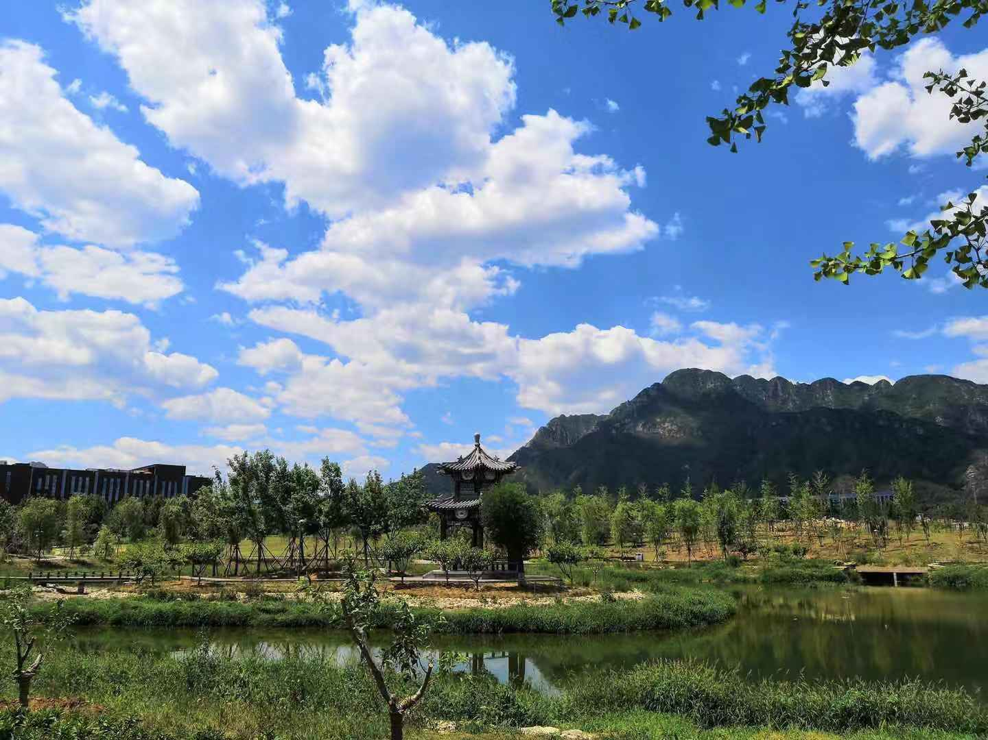
I certainly believe that each of you will have a good life in BUCT.
THANK YOU!!!

Slide 15
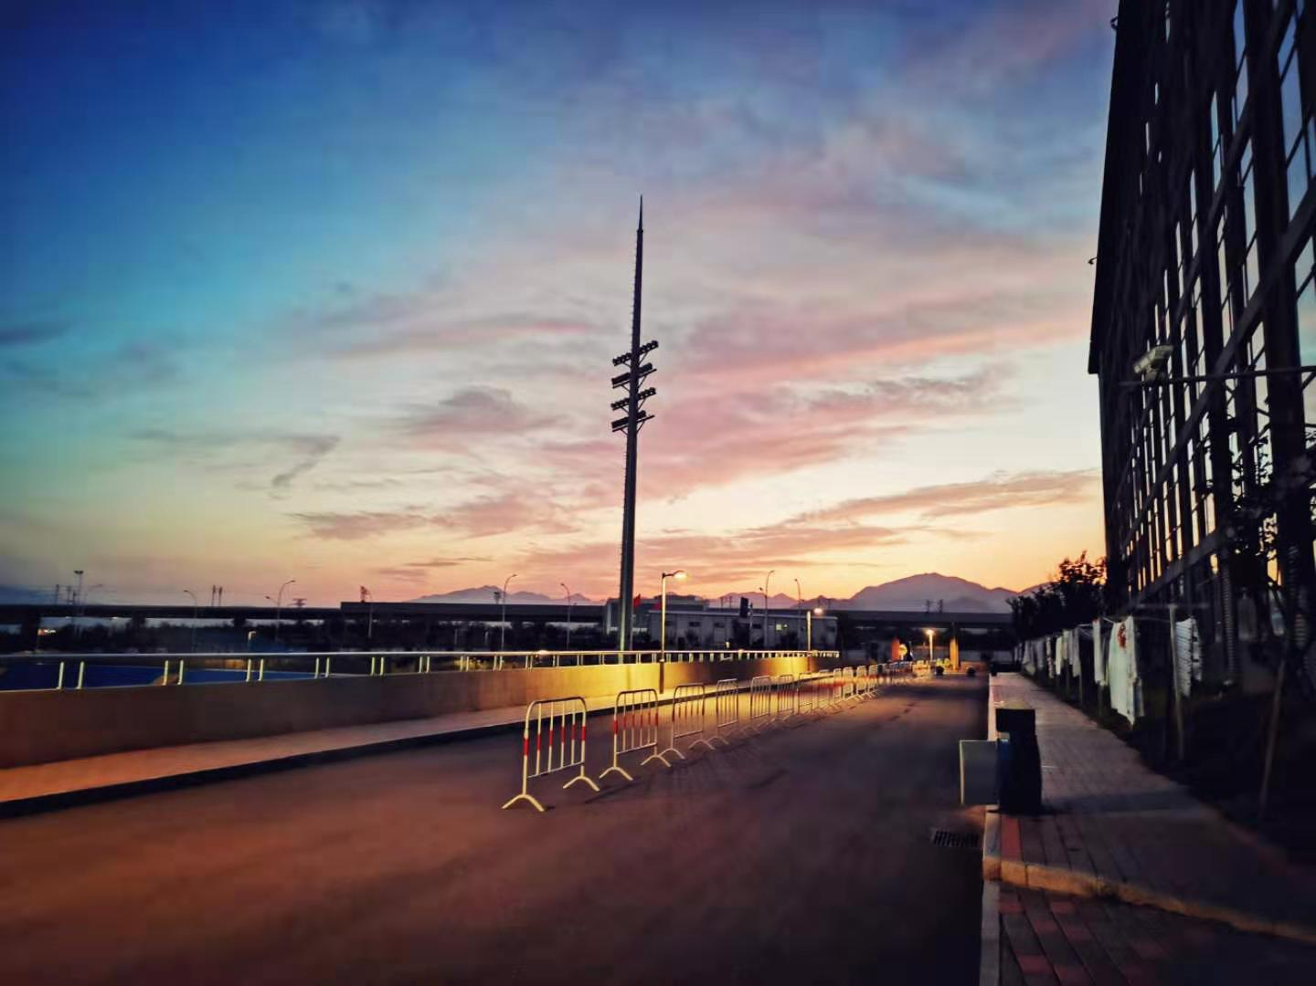
ACADEMIC RESEARCH

Slide 16

Achievement

Slide 17

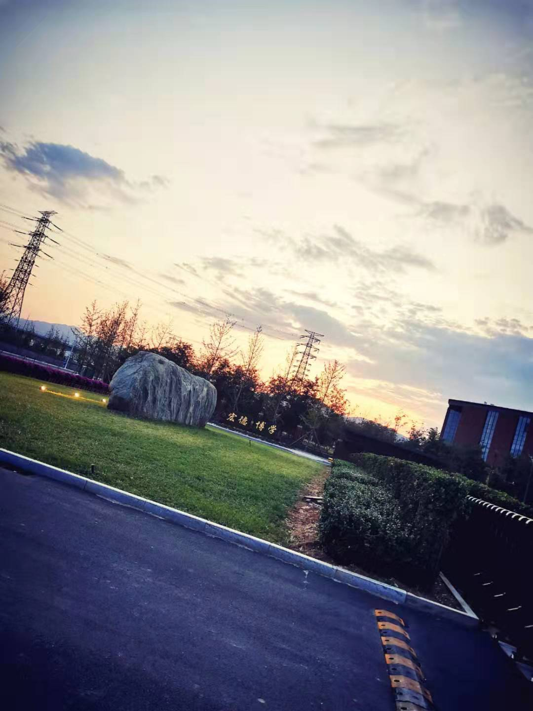
By the end of 2018,it had two national teaching base,one national college students’ culture and education base,12 national college students off-campus practice teaching base.

Slide 18
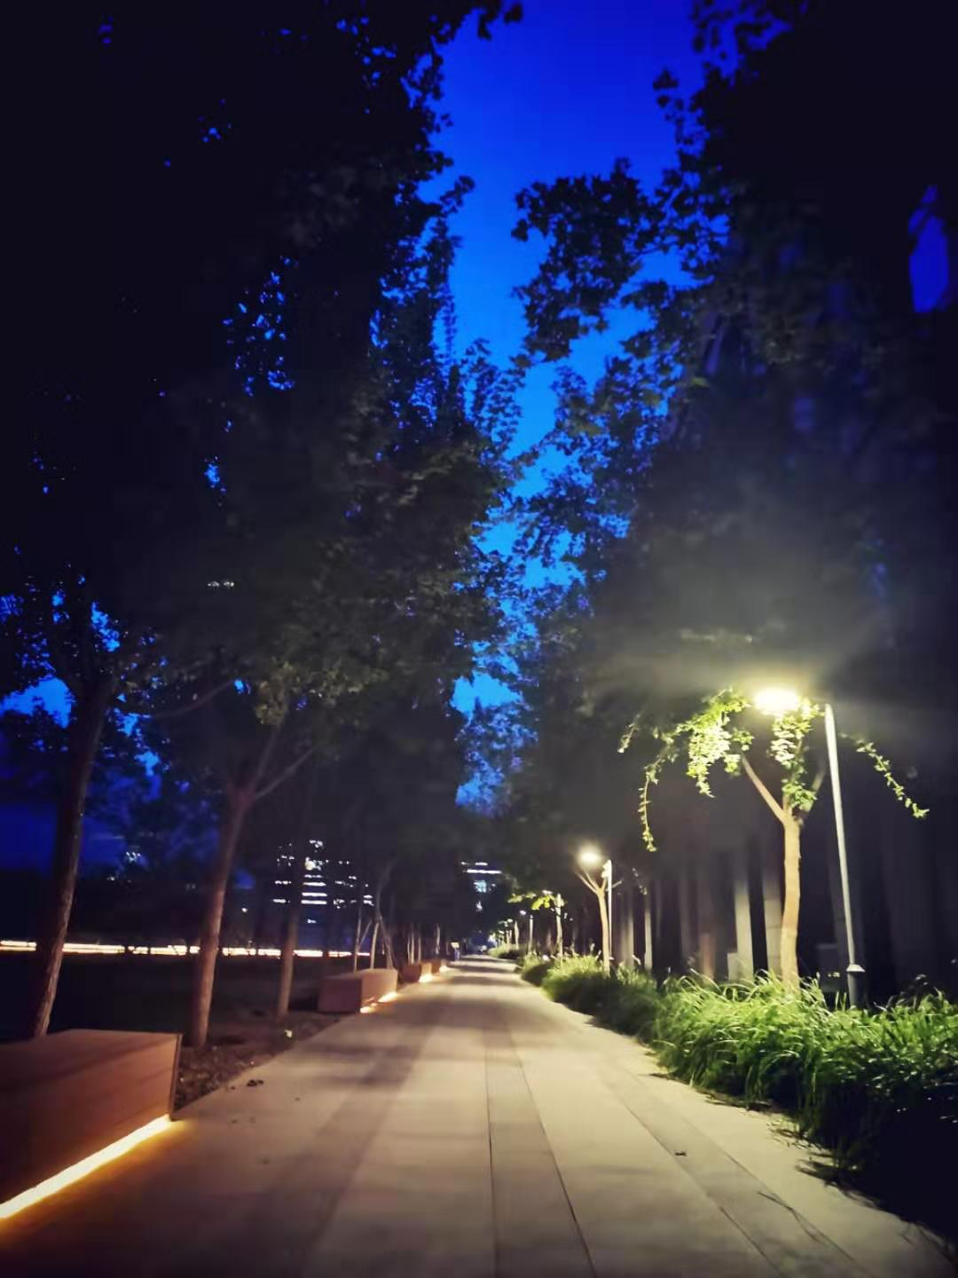
By the May 2018,the school had 26 projects for national science and teaching awards.It is one of the only three “project 211”and “985 superior discipline innovation platform” universities,which is selected for thirteen five year plan.

Slide 19
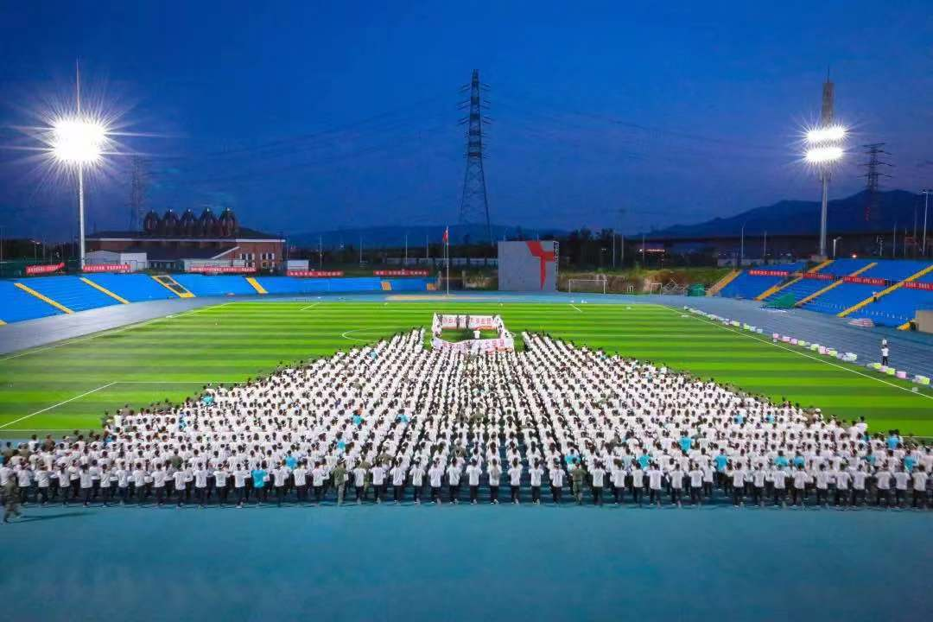
北化校园文化传统 by 吕茁佳
The motto of Beijing university of chemical technology is "宏德博学，化育天工",and its university spirit is unity ，dedication，hard work and innovation.
BUCT has three characteristics：international,academic and humanistic.
First of all, let us talk about its internationalism,it is universeily acknowledged that the BUCT has won many international awards.And many international exchange activities have been held between BUCT and world famous universities.

Slide 20
Secondly,as a university which is famous for its high standards of discipline,it is always filled with an academic atmosphere.The crowded night library can actually prove everything.
Finally,the cultrual environment.With the support of the university,all kinds of associations,such as The Student Union and The radio club ,have been well developed.Students can get comprohensive development through their active participation,and these associations have enriched students' campus life ,helped them improve their learning effciency through the combination of study and rest.

Slide 21
Famous Alumnus of BUCT
As a key university , BUCT has cultivated a large number of talents. Some of them have been the leaders in the varies areas ,others grow up like the social elite.
Now let’s talks about one of famous alumnus :Cheng Wei—the creator and CEO of Didi.

Slide 22
Born in 1983 , Cheng Wei graduated from BUCT with high scores and full capacity . He made Didi in 2012 which has brought as 12 billions yuan wealth and also makes him the NO.28th richest man in China of 2016 . What’s more , he was selected as “Twenty Most Influential People in Science and Technology” in May 2017 .

Slide 23
Final conclusion
BUCT is a dream place for students like us too achieve our goals .
So we are supposed to effectively use the resources provided from this beautiful college to gain as much knowledge as possible to let us take further educations .

Slide 24
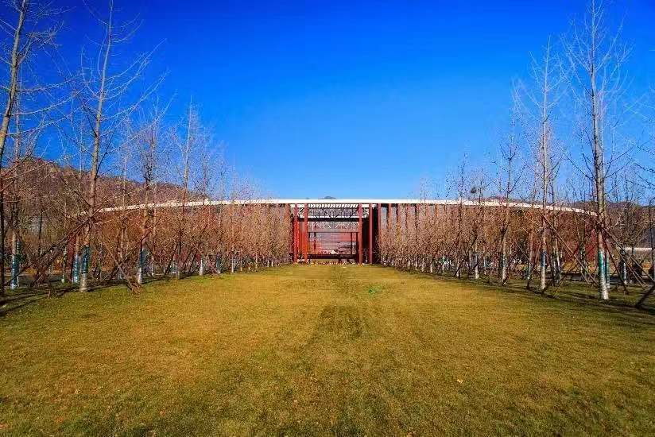
Thank you for watching!!!
From group 1

